Slide 1
Game Design Fundamentals with Godot: Lesson 1

Slide 2
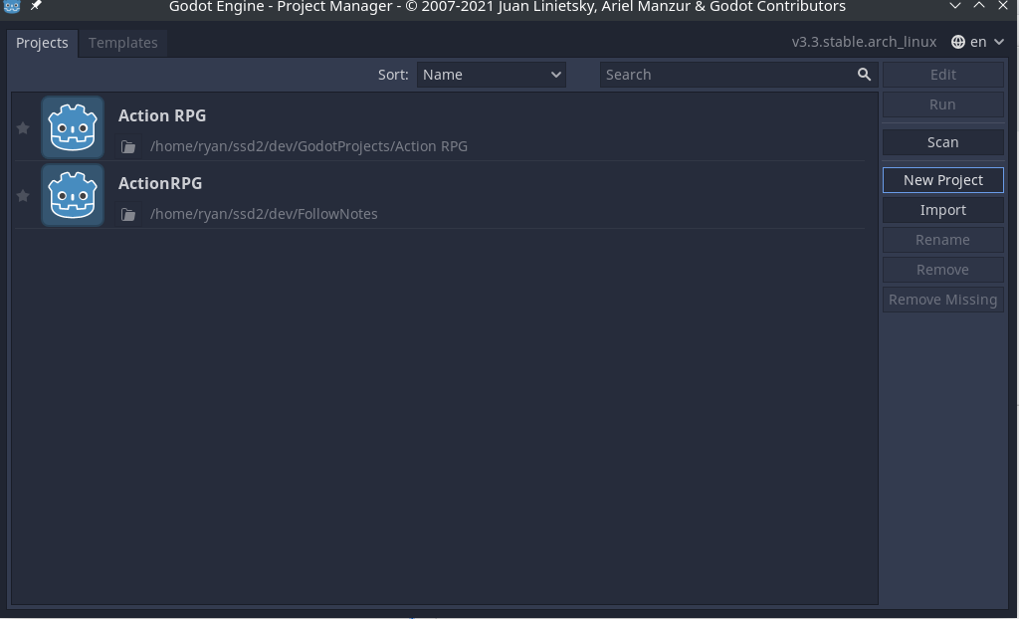
Setting up the project
Once you have downloaded Godot Engine and have it installed, the startup screen will look like this:
Clicking on the “New Project” icon will bring you into the next screen.

Slide 3
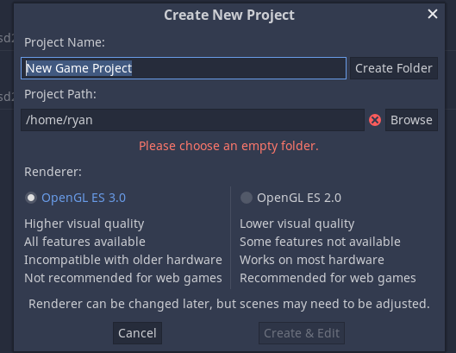
This is asking for you to select which version of OpenGL you will be using. We will start with OpenGL 3.0, but if anyone has issues launching their work we will walk through how to change to a different version later.

Slide 4
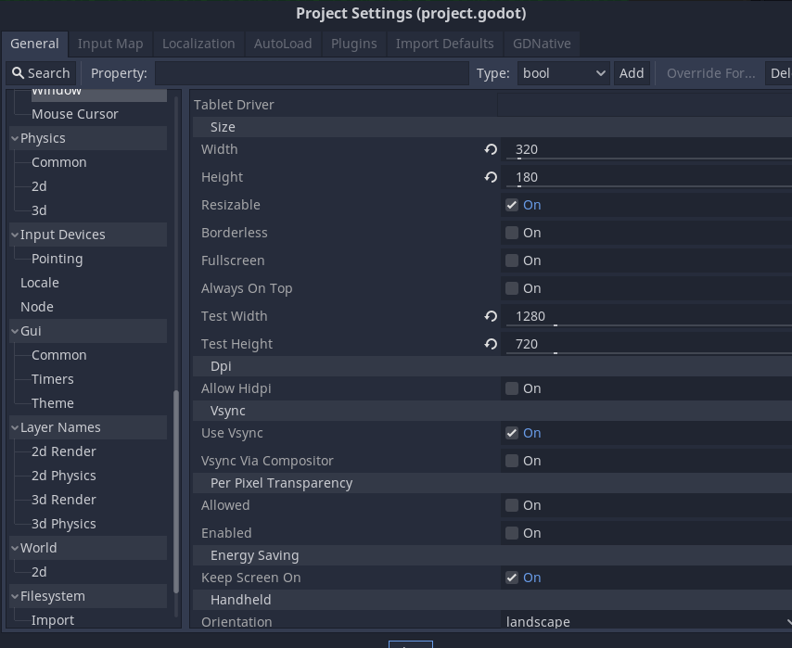
Editor Settings and Project Structure
We will only use the 2D version of Godot to start with, so we can ignore 3D entirely. We will do one additional thing starting out. We will set the screen resolution.
Under the project settings tab, we will scroll down to Display/Window. Here we can set the rendering settings. We will select 320x180, and the test window will be 1280x720 to start with and check one more item:
Set stretch mode to enabled

Slide 5
Project Structure: FOLDERS
In any good software and game design project, before you get going it’s a good idea to organize your folders now!
We do this so as we build out the project, there is no file whether we create it or its from a third party that does not have a place. It makes organization and finding this so much easier.
For this simple of a project, we will have two primary folders:
Source
Where everything we create will go, code, scenes, and more!
It is common to abbreviate source to src, which is a convention with a lot of history and many developers choose to do.
The example project will name the primary source folder Source, but if you would prefer to use src, go ahead
Assets
All the game assets that we will import.
Within each of these folders we will create new subfolders as we work.
One for players, enemies, world, maps and more.

Slide 6
Primary Gameplay Loop
The Primary Gameplay Loop: The primary game play loop is the time between the smallest decisions in your game. This is in essence the heart of game design.
Some examples:
Moving Mario in 2D or 3D space.
Moving Pacman around a maze
Choosing what each unit does in Civilization.
A general rule of thumb: if you can describe your primary loop in one sentence and don’t use the word “and”, that’s your primary loop!

Slide 7
Why the Primary Loop Matters
Much like building a house, it’s the foundation. It’s not necessarily the most exciting. But the primary loop is what the rest of the game sits on.
If the game on this smallest moment to moment, decision to decision does not feel fun to play, then your grander ideas do not matter. People don’t want to play something that isn’t fun at its core.
Notes:
It’s not exciting. I get it. But it matters.

Slide 8
Project Structure: Godot’s Conventions
In Godot, everything is called a “Scene”. You build out each scene into your full game.
Player specific behavior is handled on a Player scene.
Enemy specific behavior is handled on an Enemy scene
You combine these smaller scenes into larger scenes to build out levels

Slide 9
Planning our primary loop: The Player Movement
Player movement in 2D space will be our primary loop.
Let’s create a player scene!

Slide 10
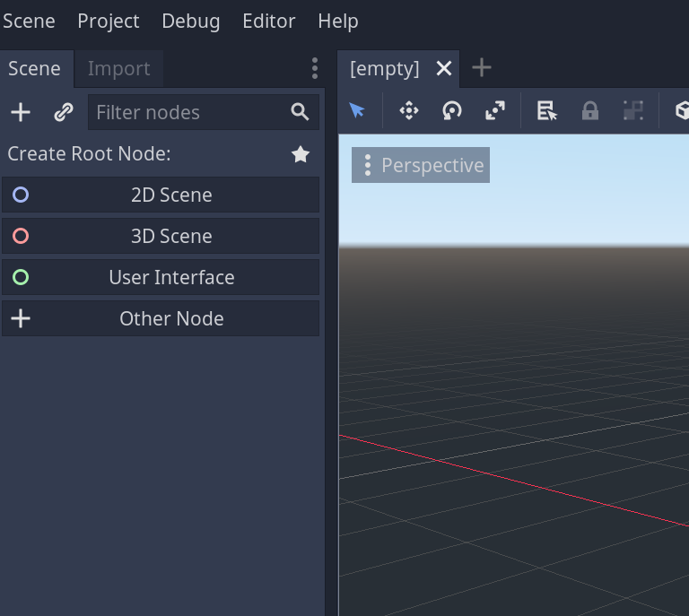
The Player Scene
The plus button to create a scene
To create a new scene, we will click the new 2D Scene button.
By default this scene will be of the type Node2D.
We want to change the type to a “KinematicBody2D”
The scene’s type
A KinematicBody2D is something that has physics and movement in 2D for Godot.
When we save the scene we will create a couple of folders inside the Source folder:
First, an Actors folder.
Inside the Actors folder, we will create a Player folder.
Why would we create a larger folder and place the player inside?

Slide 11
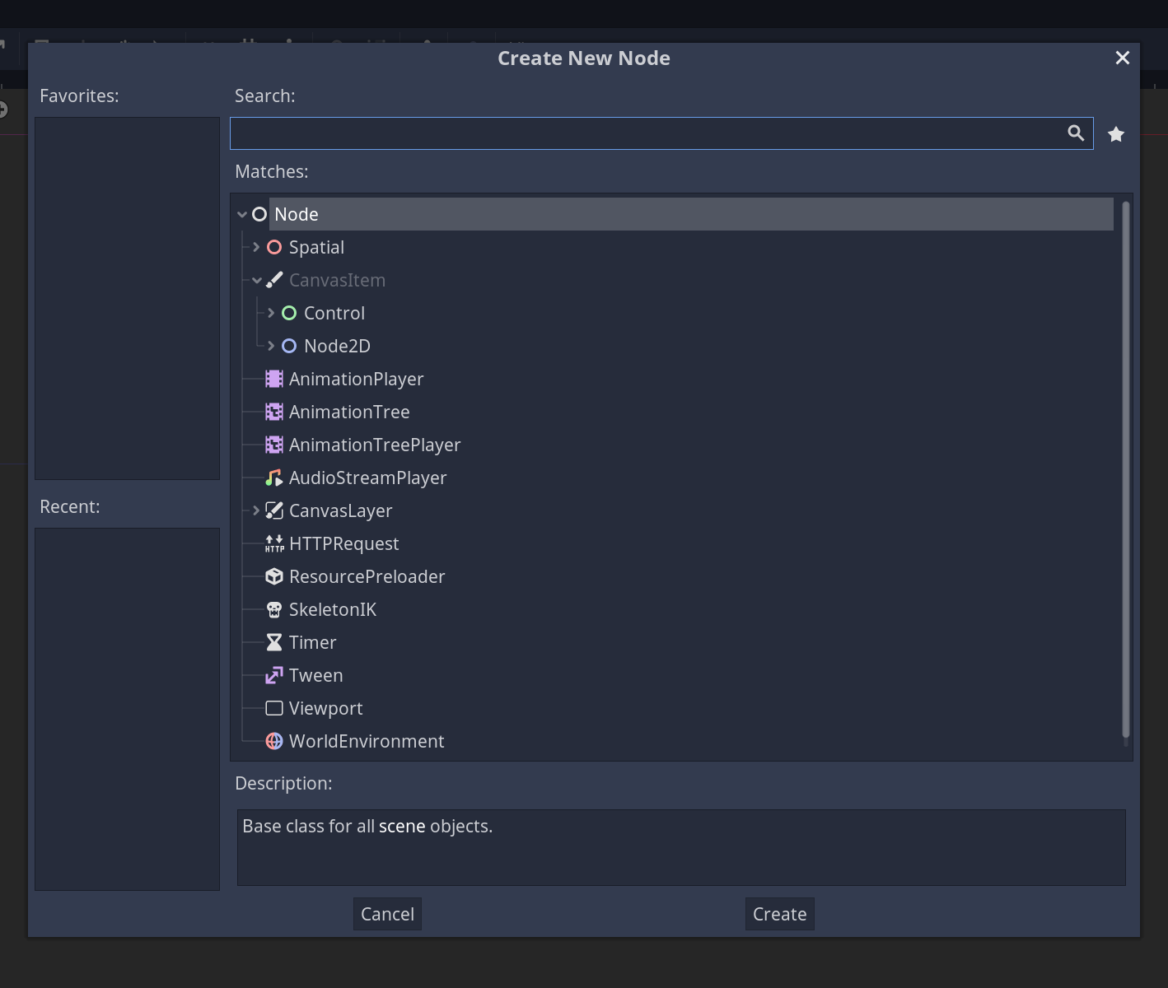
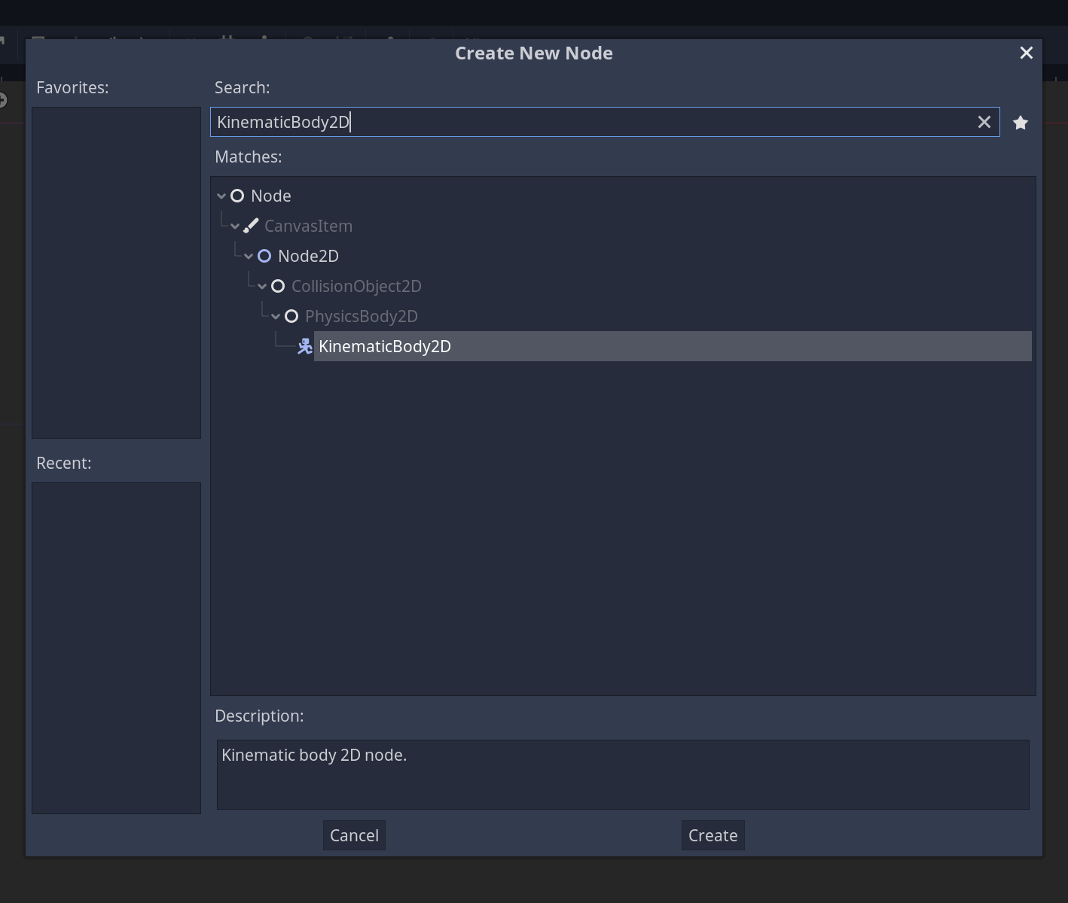
You’ll see this.
This will be the root player node.
Node Search: In the search bar, type KinematicBody2D

Slide 12
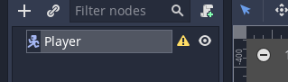
Fleshing out the Player Scene Skeleton
We now need to add some basics to the player scene before we can start making the player move
The yellow warning symbol is telling us that we are missing something the scene type needs to work!
IN this case we need to add a CollisionShape 2D
Once we create it within the structure we need to choose a shape!
We’ll choose a capsule, as that’s roughly the shape of our player

Slide 13
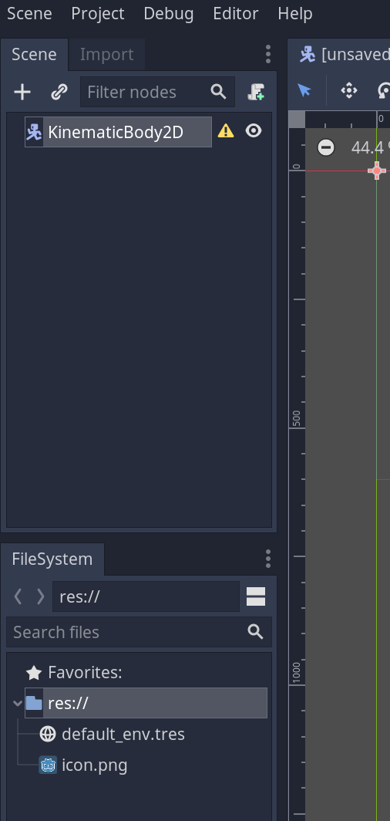
We’re gonna
rename
This to : Player
We’re gonna search for CollisionShape2D next

Slide 14
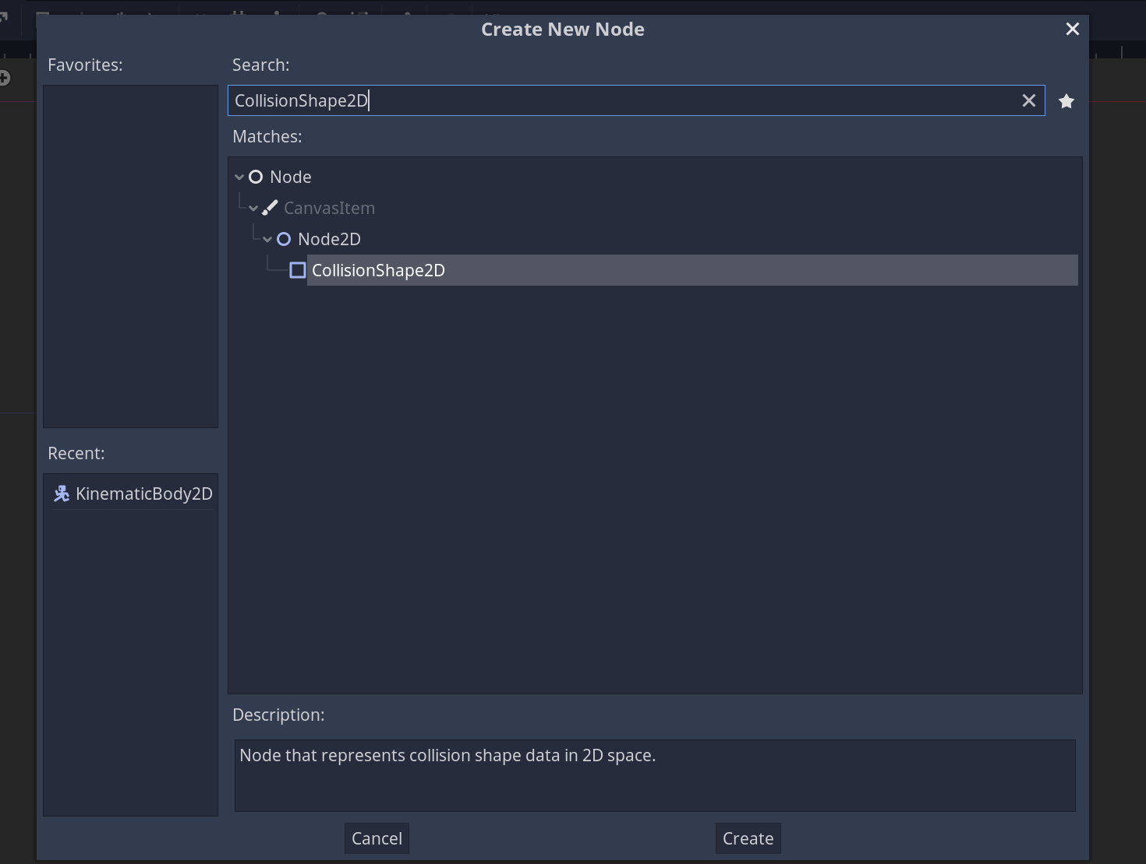
Add collision shape 2D

Slide 15
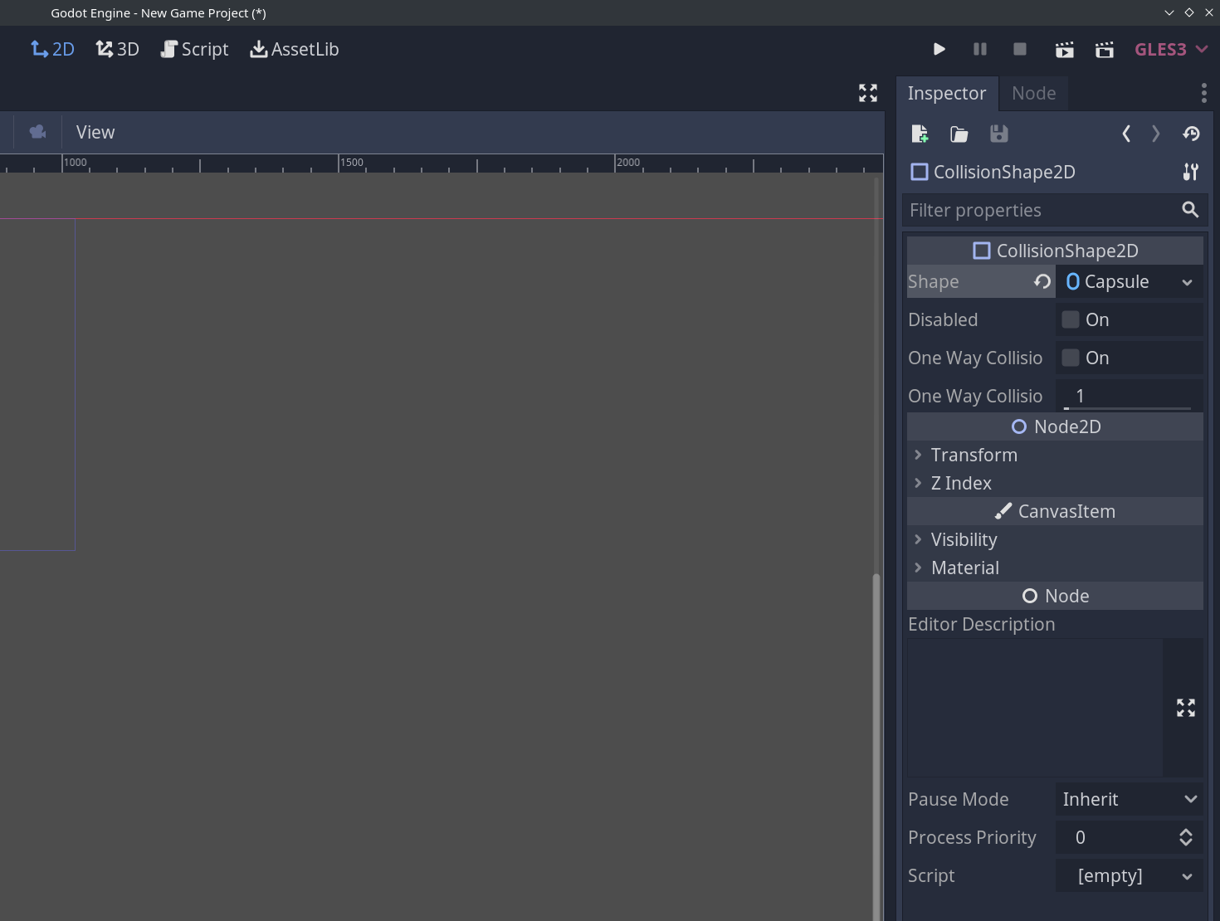
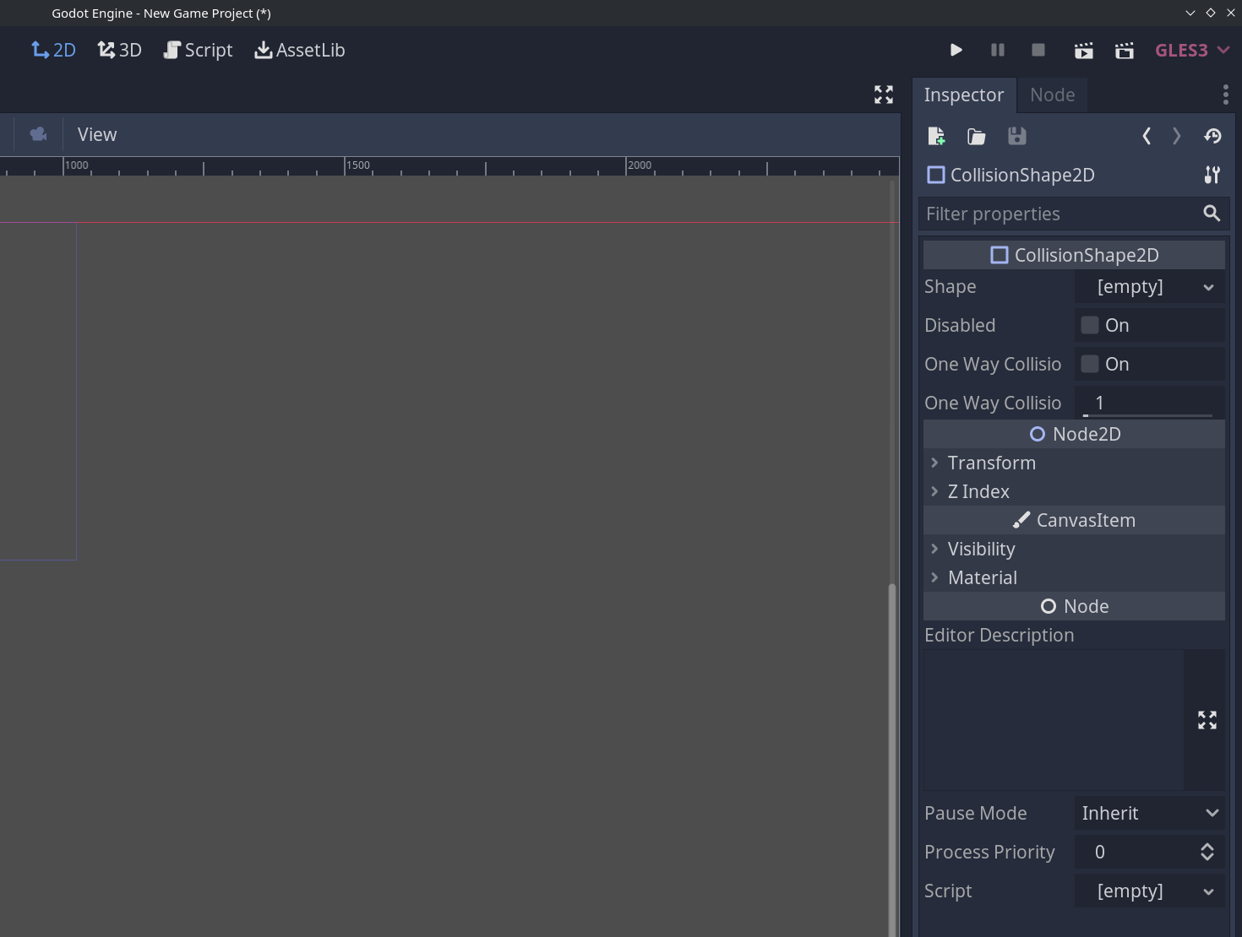
Look for: Capsule

Slide 16
Adding the Sprite!
We could drag and drop the sprite into the scene, but we just learned how to add nodes to a scene in Godot.
We’ll add a new sprite node to the scene.
Adding sprites this way centers the sprite on our scene
Then we select the Texture in the Assets folder for the player.
But it’s huge! That’s because the player asset is a sprite sheet. Which is used for animation as well, which we will get to!
We need to tell Godot to use only one frame of the sheet at a time.
On this sprite sheet, there are 60 Horizontal frames and 1 Vertical frame.
In the animation tab on the sprite node, we can set the HFrames value to 60.

Slide 17
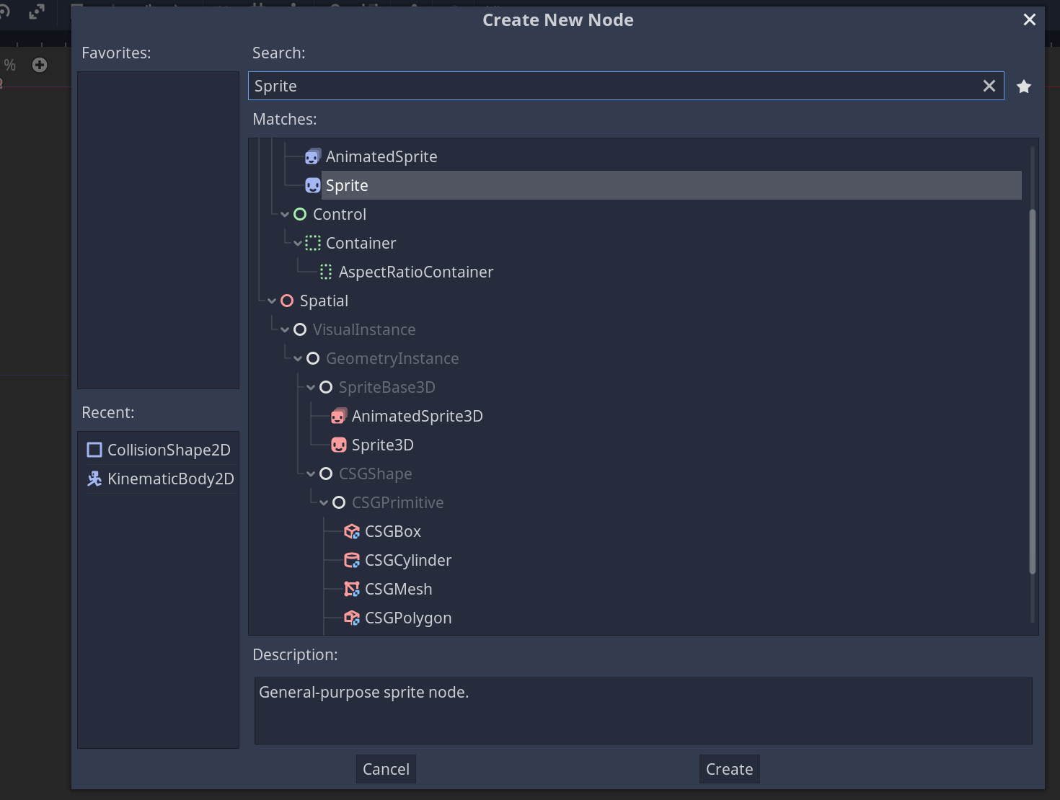
Add a sprite.
Animated sprites are like GIFs.
We want just sprite

Slide 18
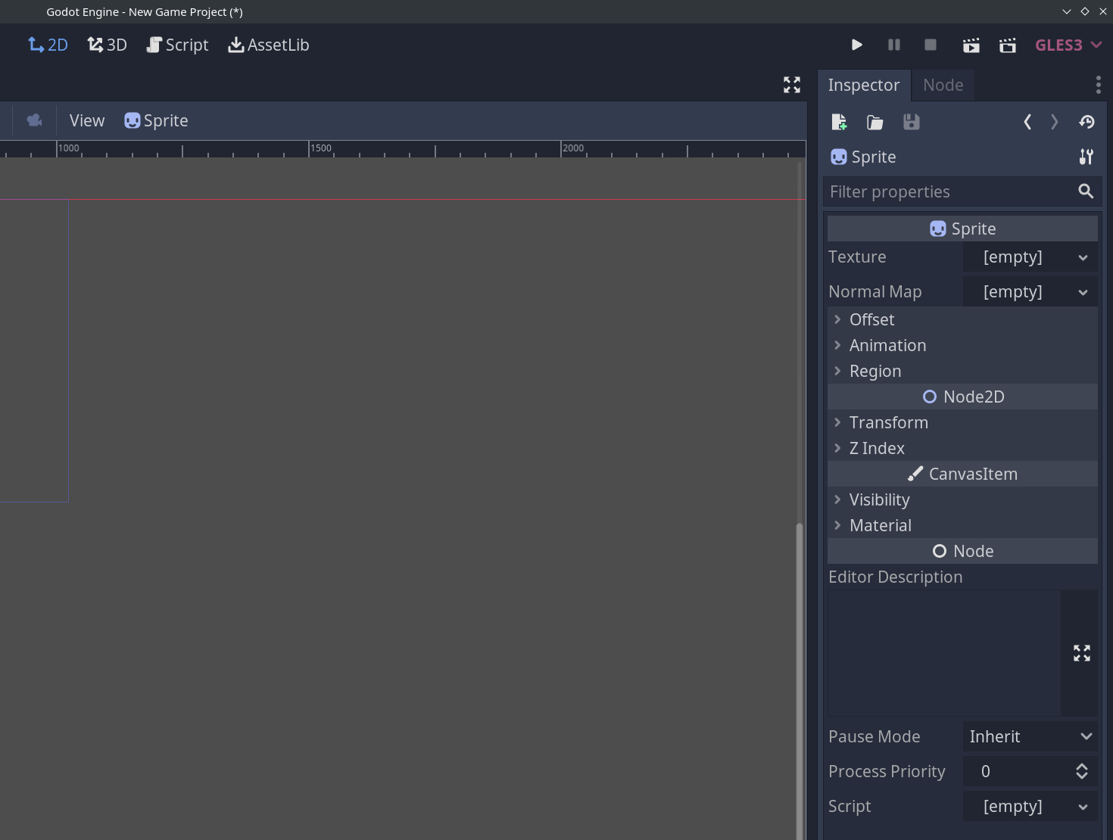
We’ll search for the player art here.

Slide 19

First Lines of CODE: Scripting the Movement!
Godot uses a programming language called Godot Scripting Language, which is heavily inspired by Python.
We can create a new script in a scene with the script icon with a plus
Godot will then ask us what kind of script we want to make, and for this project all the scripts will be GDScript.
Let’s add the Player.gd script into Source/Actors/Player/ folder.

Slide 20
The Two Primary Functions in a Godot Script
_physics_process(delta)
_ready()
What do you think these two do?

Slide 21
Planning and Writing the Movement Function
Discussion: Should the function that reads player input be called in _ready() or _physics_process(delta)?
Godot reads 2D space as 2 dimensional vectors, so we can take advantage of a library called Vector2.
We want to read the input on the X and Y planes, and calculate the movement speed of the character, then move them on the screen.

Slide 22
Some general GDScript Things to Keep In Mind
If you’re creating a function definition you know you’ll need, but don’t have anything to put in it yet, you can use the pass keyword.
Private variables and functions are prefaced with an underscore in Godot.

Slide 23
After first launch
It looks like the Sprite is very small! This is because we forgot to do something back when we set the window size!
We need to enable 2d stretch mode in the window

